Slide 1
Service Broker - Put Me In Coach
~ Wolf ~

Slide 2




#sqlhelp
#sqlsatChattanooga
Notes:
Add slides to each topic section as necessary, including slides with tables, graphs, and images.
See next section for sample table, graph, image, and video layouts.

Slide 3

About Wolf
DBA for 16 years(5 MSSQL, 5 ORACLE, 6 MSSQL)
At RDX for over 5 years. “Manager – SQL Server Performance Tuning”
Works with a variety of clients and challenges
Notes:
Give a brief overview of the presentation. Describe the major focus of the presentation and why it is important.
Introduce each of the major topics.
To provide a road map for the audience, you can repeat this Overview slide throughout the presentation, highlighting the particular topic you will discuss next.

Slide 4
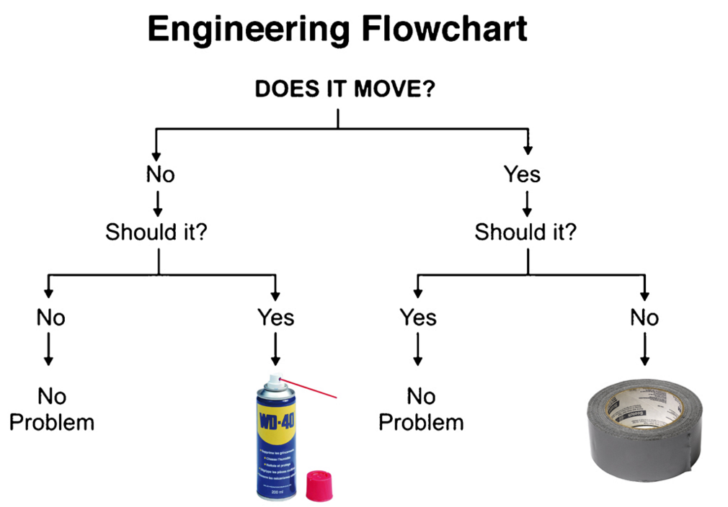
http://25.media.tumblr.com/tumblr_m1mnb7CvtP1rrr8v1o1_1280.jpg

Slide 5
What We Will Focus On
1
Service Broker Overview
2
Uses for Service Broker
3
Service Broker Objects
4
Service Broker, ETL/Replication alternative
Notes:
This is another option for an Overview slide.

Slide 6
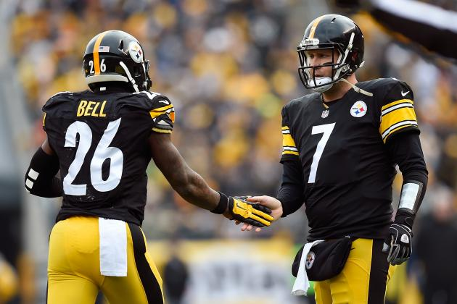
What is Service Broker?
ASYNCHRONOUS delivery and processing of messages
Messages are delivered in order
SQL Server uses Service Broker for Database Mail
Core feature since SQL Server 2005
http://img.bleacherreport.net/img/slides/photos/003/973/168/hi-res-e85e6c530a85b88c5f82684c5de82bbb_crop_north.jpg?w=630&h=420&q=75
Notes:
Asynchronous delivery and processing of messages sent within a database or between databases (either on the same instance or in separate instances. Think of it as email processing
Resource contention relief
message

Slide 7
Key Terminology/Components
Message Types
Contracts
Queues
Services
Conversations
Endpoints
Routes
Notes:
Uses queues
Messages always delivered in order as long as sent on same conversation
Can and should encrypt messages

Slide 8
Uses For Service Broker
Asynchronous processing such as order fulfillment and credit card transactions
Near real-time ETL
Alternative to replication
Data Sharding

Slide 9
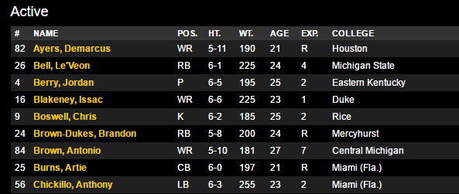
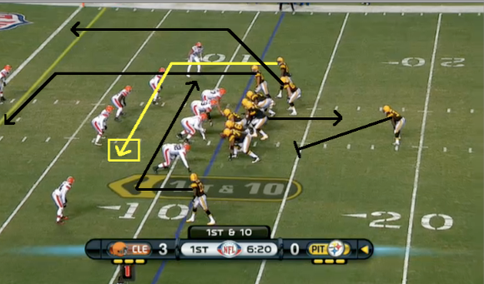
Message Types
Send Messages to/from databases on:
The same instance
Different instances, same server
Different Servers
CREATE MESSAGE TYPE sb_MessageType_Steelers_Roster
AUTHORIZATION dbo VALIDATION= WELL_FORMED_XML
CREATE MESSAGE TYPE sb_MessageType_Steelers_Plays_Processing
AUTHORIZATION dbo VALIDATION= WELL_FORMED_XML
http://cdn.cloudfiles.mosso.com/c1910342/media_center/images/static/media_box/Big.png
Notes:
In order to hold a conversation using Service Broker, we first have to specify one or more message types. A Message Type is simply a logical way for you to specify what kind of content will be contained in a message. Define message type based on its contents.

Slide 10
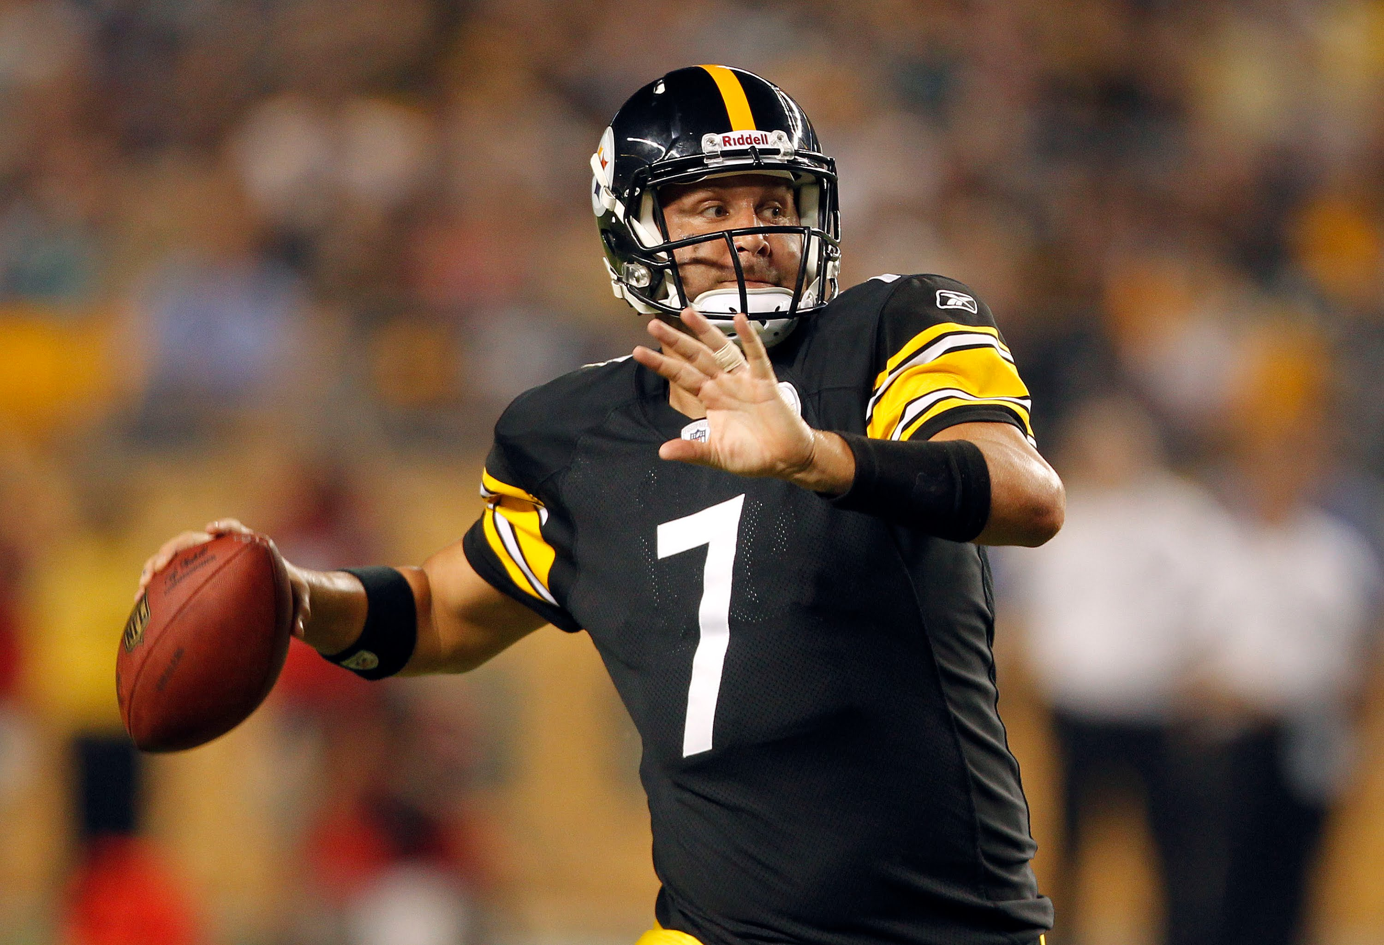
Contracts
Once Message Types are defined, Contracts are created to determine who is allowed to send messages, and in which direction
CREATE CONTRACT sb_contract_Steelers_Plays_Processing
AUTHORIZATION dbo
(
sb_MessageType_Steelers_Plays_Processing
SENT BY ANY)
GO
https://i.ytimg.com/vi/w1T5xSMlTYA/maxresdefault.jpg
Notes:
Contracts define the name of a specific business task and list the message types used in that task. Service Broker contracts define two different service roles: the initiator and the target. The initiator of a conversation begins the conversation by sending a message to the target. The contract that the conversation uses defines which service role can send messages of a given message type.
For each task that the service performs, create a contract that includes the message types for each step in the task. For each message type, specify whether the message type is sent from the initiator to the target, from the target to the initiator, or in both directions.
A contract does not specify message ordering or the number of messages of a particular type that can be sent. Service Broker requires that the initiator send the first message in a dialog conversation. After the first message, there are no ordering requirements.
More than one contract can use the same message types. For example, a message that consists of an XML document that contains a part number and quantity may be useful in a task that accepts an order from a customer, a task that manages inventory, and a task that requests shipping. Each task corresponds to a distinct contract, but all three contracts can use the same message type.

Slide 11
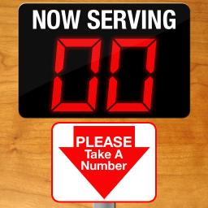
Queues
Message storage until the message can be handled
Possible to automatically activate a messaging handling system
CREATE QUEUE sb_queue_Steelers_Plays_Processing
WITH
STATUS= ON,
RETENTION= OFF
GO
https://static-s.aa-cdn.net/img/ios/317787057/dda7d412fc6dbbdb65abc0ce6d3940d7?v=1
Notes:
Talk about the first 15 plays in redskins game being scripted. Place where messages are stored until they are delivered or received. Can be internal or external. I have NOT done external.

Slide 12
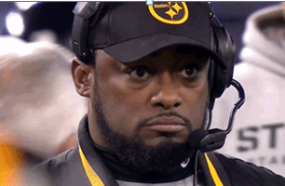
Services
Send messages to their queues or receive messages from other senders
CREATE SERVICE [sb_srvc_Steelers_Alpha]
AUTHORIZATION WR01_ALPHA_User
ON QUEUE sb_queue_Steelers_Alpha
([sb_contract_Steelers_Sync])
GO
https://i.kinja-img.com/gawker-media/image/upload/xfv0mwweipwck4qag7bn.gif
Notes:
Send the messages to the queue on their destination. Receive messages from senders.

Slide 13
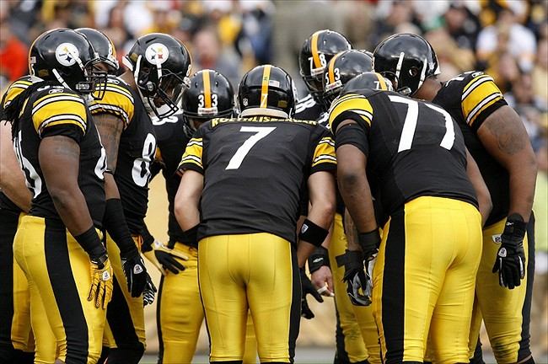
Conversations
This is the channel that the services send and receives messages from the queues
BEGIN DIALOG CONVERSATION @conversation_handle
FROM SERVICE @FromService
TO SERVICE @ToService
ON CONTRACT @Contract
WITH ENCRYPTION= ON;
SEND ON CONVERSATION @conversation_handle
MESSAGETYPE @MessageType(@MessageBody);
http://stillcurtain.com/wp-content/blogs.dir/58/files/2013/09/57711161.jpg
Notes:
This is where we begin a dialog from an internal URN to an external URN

Slide 14

Poisoned Messages
https://upload.wikimedia.org/wikipedia/en/thumb/f/ff/Poison_Help.svg/1024px-Poison_Help.svg.png

Slide 15
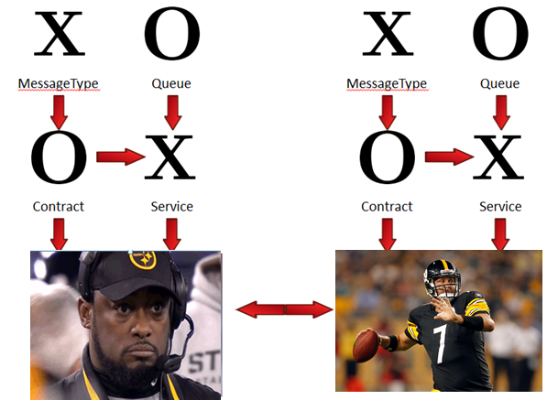
Will The Diagram Help?
https://i.kinja-img.com/gawker-media/image/upload/xfv0mwweipwck4qag7bn.gif
https://i.ytimg.com/vi/w1T5xSMlTYA/maxresdefault.jpg

Slide 16
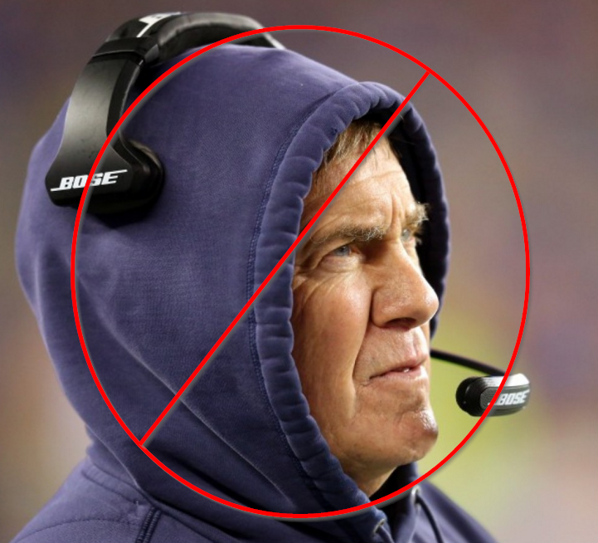
Demo
https://img.washingtonpost.com/wp-apps/imrs.php?src=https://img.washingtonpost.com/rf/image_908w/2010-2019/Wires/Images/2015-01-18/Getty/461744110.jpg&w=1484

Slide 17
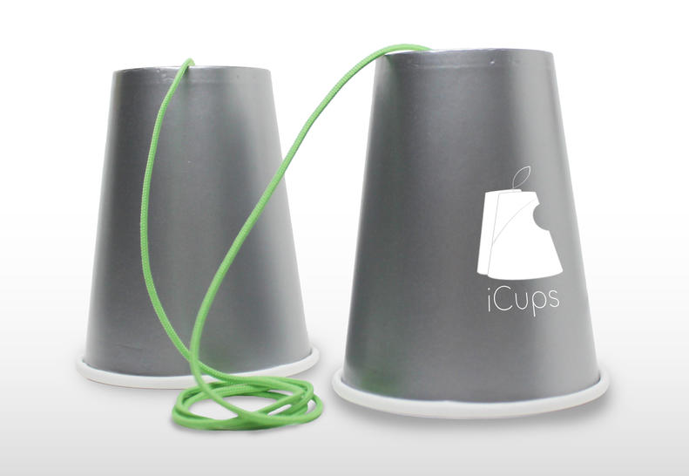
Endpoints
A SQL Server endpoint is the TCP/IP point of entry into SQL Server.
This is how the service broker dialogs are directed
CREATE ENDPOINT WAREWOLF_ALPHA_Endpoint
STATE= STARTED
AS TCP ( LISTENER_PORT = 4022 )
FOR SERVICE_BROKER (AUTHENTICATION = WINDOWS );
GO
GRANT CONNECT ON ENDPOINT::[WAREWOLF_ALPHA_Endpoint] to [SQLWAREWOLF-LAP\sqlwarewolf]
GO
http://cnet1.cbsistatic.com/hub/i/r/2014/09/11/4fd0b9ca-10cc-46d8-a055-4c5fec2e05f3/resize/970x546/e04b33c5881a7cf1ca11b6bee139a9a6/icups.jpg

Slide 18

Routes
This is how SQL Server knows where to send our message
A route needs to be created in the database as well as MSDB
CREATE ROUTE sb_route_Steelers_Wolfpack
AUTHORIZATION dbo
WITH
SERVICE_NAME = N'sb_srvc_Steelers_Wolfpack',
ADDRESS = N'TCP://localhost:4023'
GO
USE msdb;
GO
create ROUTE sb_route_Steelers_Alpha
AUTHORIZATION dbo
WITH
SERVICE_NAME = N'sb_srvc_Steelers_Alpha',
ADDRESS = N'LOCAL'
GO

Slide 19
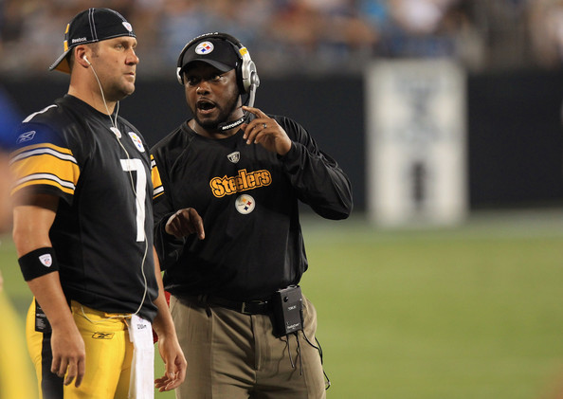
Remote Service Binding
Creates a “partnership” between the Remote Service and the local service.
Defines the security between the two
USE PittsburghSteelers
GO
CREATE REMOTE SERVICE BINDING [WR02_WOLFPACK_Binding]
AUTHORIZATION dbo
TO SERVICE N'sb_srvc_Steelers_Wolfpack'
WITH USER = [WR02_WOLFPACK_User]
GO
GRANT SEND
ON SERVICE::[sb_srvc_Steelers_Alpha]
TO WR02_WOLFPACK_User;
http://www2.pictures.zimbio.com/gi/Ben+Roethlisberger+Mike+Tomlin+Pittsburgh+N_ZC6SpGyerl.jpg

Slide 20

Demo
http://www.obnoxiousbostonfan.com/wp-content/uploads/2015/01/NewEngland_logo-1.jpg

Slide 21
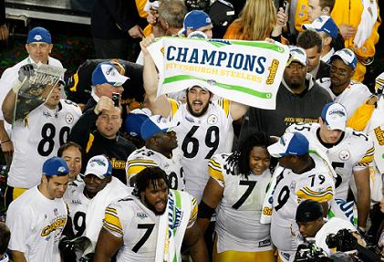
http://assets.sbnation.com/assets/64834/ba0f03b3298e0bb8ea6478b2d0c71445-getty-80670228mh272_super_bowl_xl_1_.jpg

Slide 22
Resources
http://sqlblog.com/blogs/allen_white/archive/2010/01/06/service-broker-basics.aspx
http://itknowledgeexchange.techtarget.com/sql-server/using-service-broker-instead-of-replication/
http://www.sqldiablo.com/2012/03/04/service-broker-overview/
http://sqlperformance.com/2014/03/sql-performance/configuring-service-broker

Slide 23
Questions?

